Slide 1

ENGR-E516 Engineering Cloud Computing
Format 360: Multi-Format File Conversion Engine on Google Cloud
By:- Vaishnavi Pawar
Shreya Parab
Vaishnavi Rai

Slide 2
Table of Contents
Introduction
Motivation
Related Work & Gap Analysis
Achieved Result
Architecture
Algorithm Selection
Results
Future Development

Slide 3
Introduction
Format 360 harnesses Google Cloud Platform's serverless architecture for an integrated, scalable file conversion service, bridging the market gap with its comprehensive and seamless functionality.
Format 360 uses GCP’s serverless computing, including Cloud Run and Cloud Functions, to efficiently handle multiple file formats, for cost-effective flexibility.

Slide 4
Motivation
Addressing Market Gaps:
Existing tools lack seamless integration and comprehensive format support.
Format360 addresses the need for a unified solution that integrates seamlessly across different platforms, reducing dependency on multiple tools.
Utilizing Advanced Technology:
Many tools fail to utilize the full potential of cloud computing.
Format 360 exploits Google Cloud Platform’s serverless infrastructure for improved efficiency and cost-effectiveness.

Slide 5
Related Work and Gap Analysis:
Existing Solutions Limitations:
Current tools like Zamzar and CloudConvert lack scalability, integration, and support for multiple formats.
Identifying Market Deficiencies:
Many tools fail to integrate into broader tech ecosystems, highlighting the need for a cohesive and adaptable tool like Format 360.
Technological Superiority:
Utilizes Google Cloud’s serverless computing to enhance scalability, maintain cost-effectiveness, and ensure high performance under diverse conditions.

Slide 6
Achieved Result
Scalable architecture that can accommodate an increase in conversion demands without compromising service quality.
We utilized Google Cloud Platform's comprehensive infrastructure for Format 360, including Cloud Run, Cloud Functions, Cloud Storage, and Cloud Pub/Sub.
Additionally, Docker containerized the application, ensuring consistency across development, testing, and production environments.

Slide 7






ARCHITECTURE FOR FORMAT 360
Cloud Storage
uploads file
trigger on
upload
Embeddings
read files
Publish msg
Cloud Pub/Sub
Cloud Functions
Cloud Run
Triggers on Cloud Storage
Triggers AI Platform to
extract data in files
PUSH metadata to Cloud SQL
GCP API
Front End
read files for parsing
User
AI Platform

Slide 8
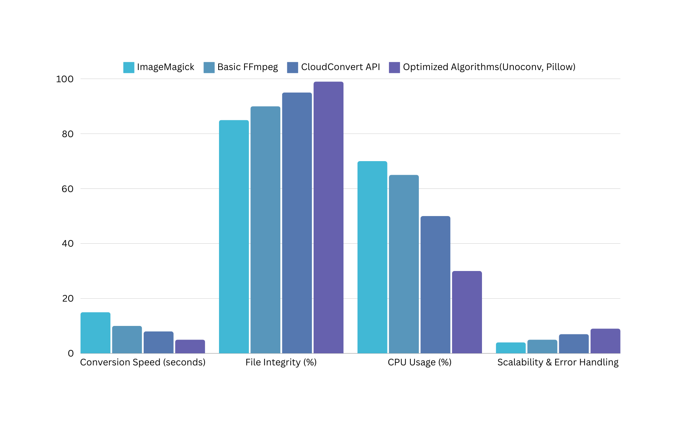
Comparison :

Slide 9
DEMO TIME!

Slide 10
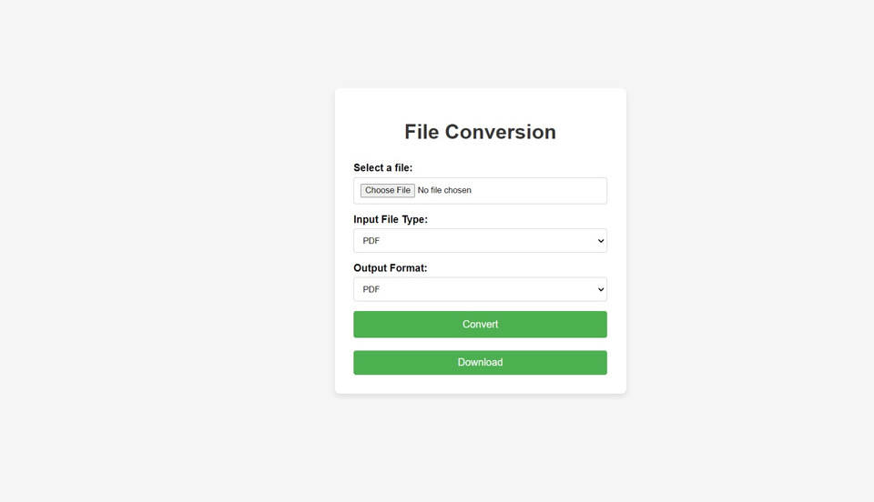
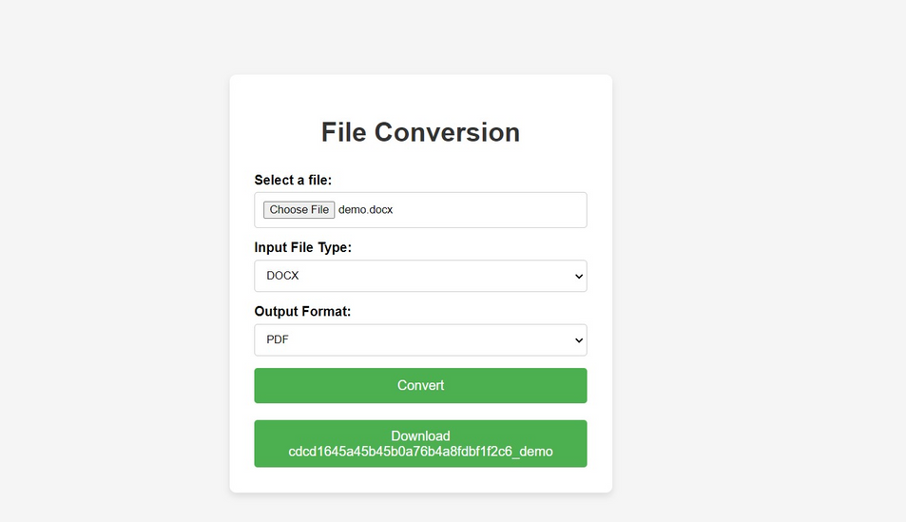
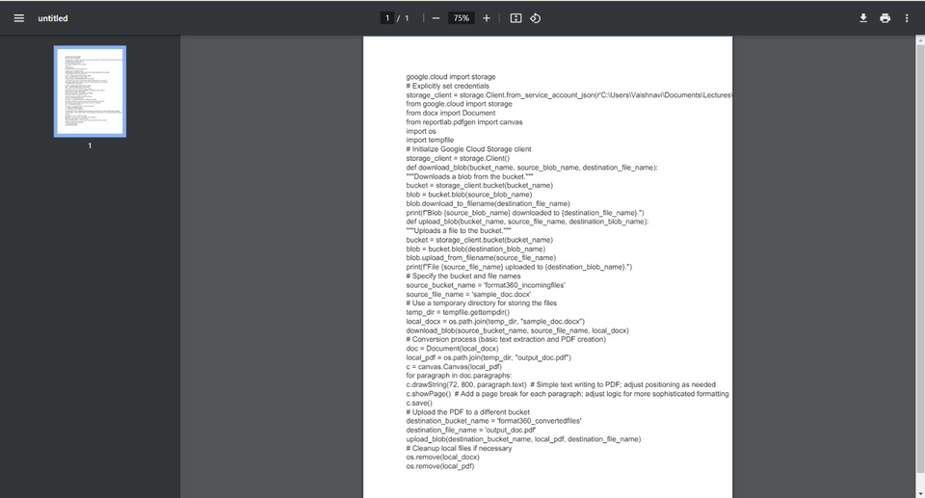
RESULTS:
Main Page - Upload the File to Convert
Main Page - Select the conversion Type & Convert
Download Preview & Download the file
Main Page - Download the file

Slide 11
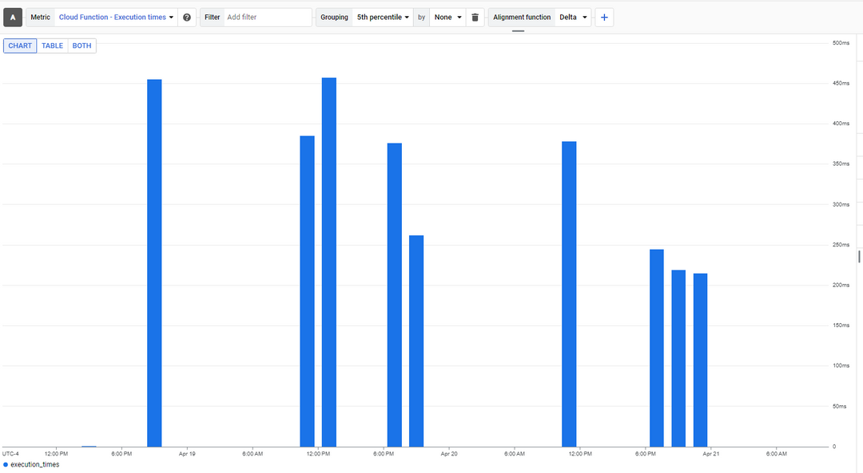
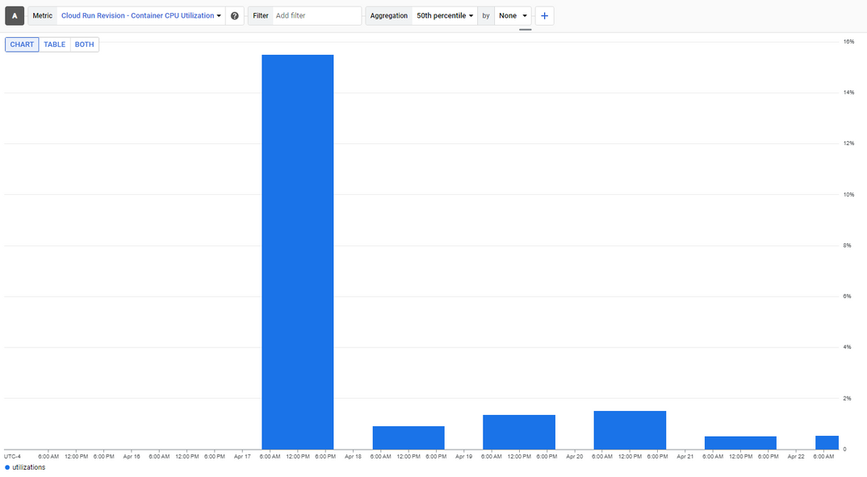
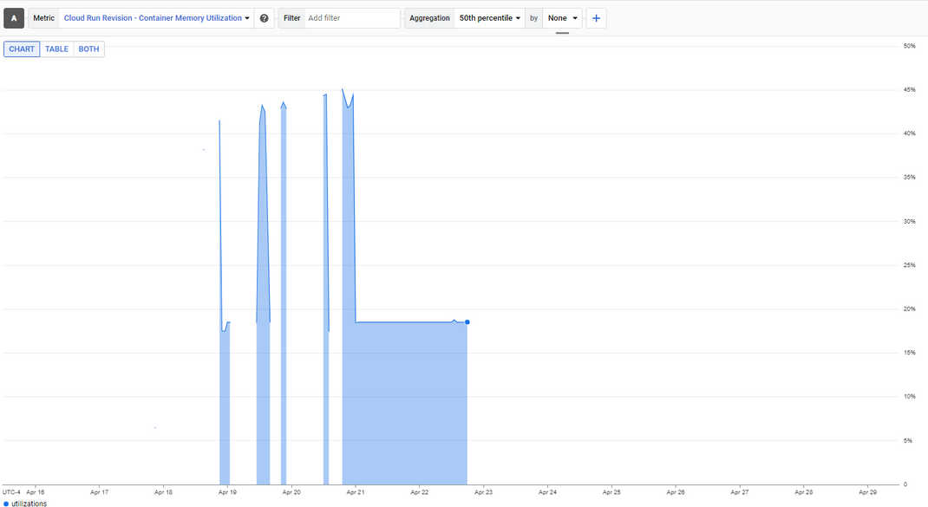
Cloud Function - Execution Time
Cloud Run - Container CPU Utilization
Cloud Run - Container Memory Utilization

Slide 12
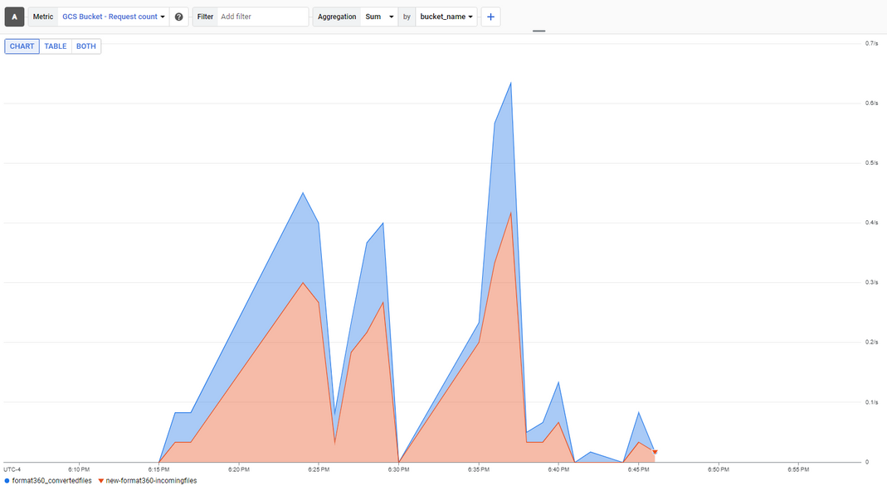
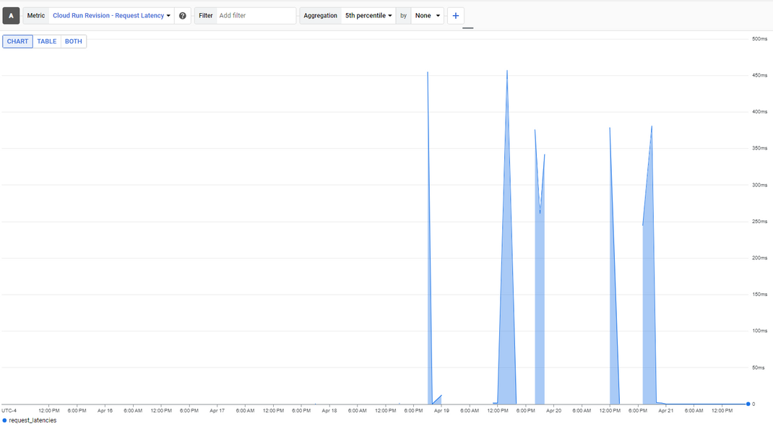
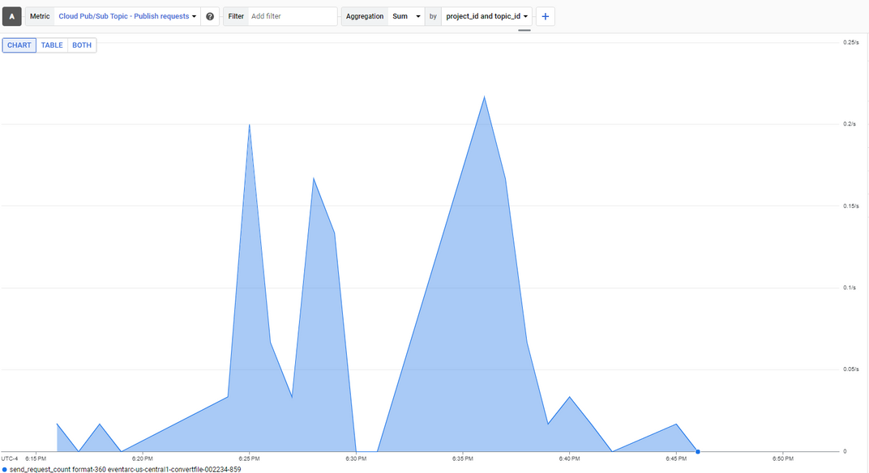
Request Latency
Bucket - Request Count
Cloud Pub/Sub - Publish Message Count

Slide 13
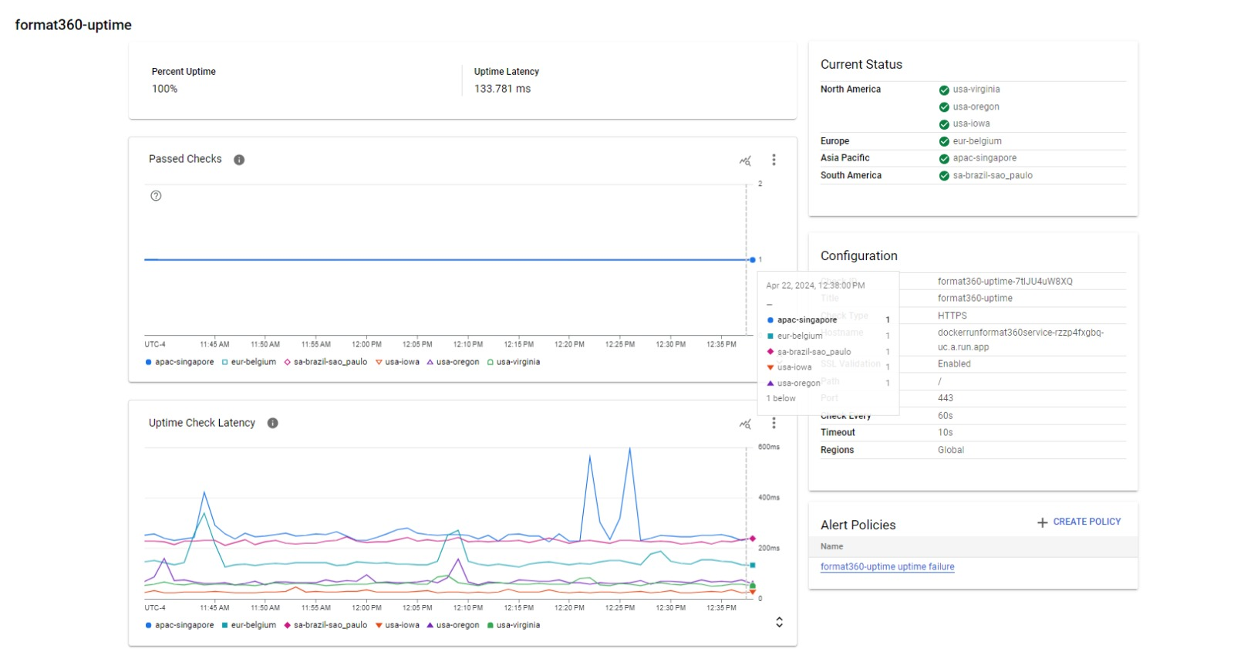
Uptime Check Latency

Slide 14
Scope for future development
1. Enhanced Conversion Capabilities:
Expand the range of supported file formats, including specialized formats used in industries like healthcare or engineering.
2. Integration with Additional Cloud Services:
Provide tighter integration with other GCP services, such as AI Platform for implementing machine learning-enhanced features.
3. Security Features:
Integrate more advanced security measures such as anomaly detection to protect against new and emerging threats.

Slide 15
Thank you

